Slide 1
HOME MONITORING SYSTEM
David Wachenschwanz
Fall 2017 UCSC IoT x413

Slide 2
Home Monitoring System Description
Multiple Inexpensive “dumb” Sensors Throughout Home Including Outdoors
9 Sensors Used in Demo
Each sensor contains Moteino (Atmel Atmega328 MCU), HopeRF RFM69HCW ISM Transceiver, Bosch BME280 and 18650 PCB-Protectd 3.7V Li-Ion Battery (2600 mAh)
Transmits Temperature, Pressure, Humidity & Battery Voltage ~ Once-per-Minute, Otherwise goes into Deep Sleep Mode to Preserve Battery Life
Programmed in C++ Using Arduino Development Environment
1st Raspberry Pi 3 Gateway
HopeRF RFM69HCW Transceiver connected to SPI0 for received data from “dumb” sensors
MQTT Gateway: C program running as daemon to receive data from “dumb” sensors and then publish data by MQTT over internal network. RFM69HCW connected by SPI0 and GPIO lines for interrupts
2nd Raspberry Pi 3 Gateway
MQTT-to-MongoDB Service: Python program running as a Linux service to subscribe to MQTT stream and save Temperature, Pressure, Humidity and Battery Voltage data to a MongoDB database
Flask Server: Flask server for providing overview of current sensor readings as well as for plotting data over a specific time period by location
Gigabyte Mini PC GB-BXi5-4570R: Hosting MongoDB in Ubuntu 16.04 LTS Linux
NOTE: In the future, the MQTT Gateway and MQTT-to-MongoDB Service may be combined into one service and the MQTT portion eliminated.

Slide 3
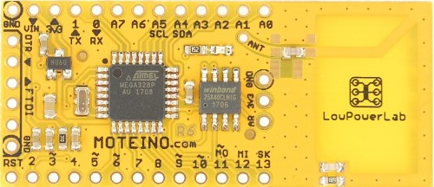
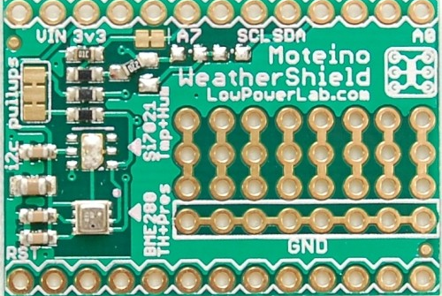
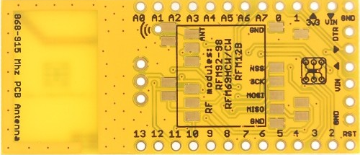
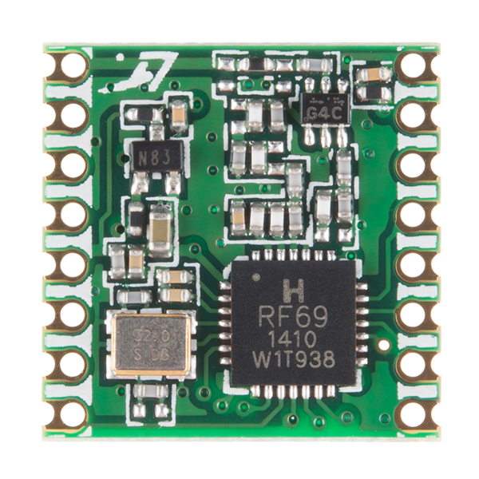

Moteino with RFM69HCW Transceiver & BME280 Shield
Moteino Front
BME280 Shield
Onboard battery monitor from VIN, reading on A7, through a 2/3 (1MEG+2MEG resistor divider) and p-channel MOSFET to control powering on & off.
Moteino Back w/RFM69HCW
Supplier: https://lowpowerlab.com

Slide 4
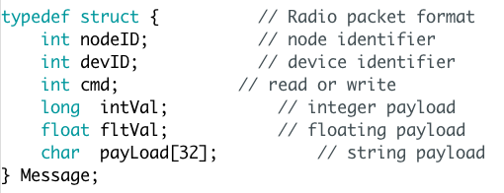
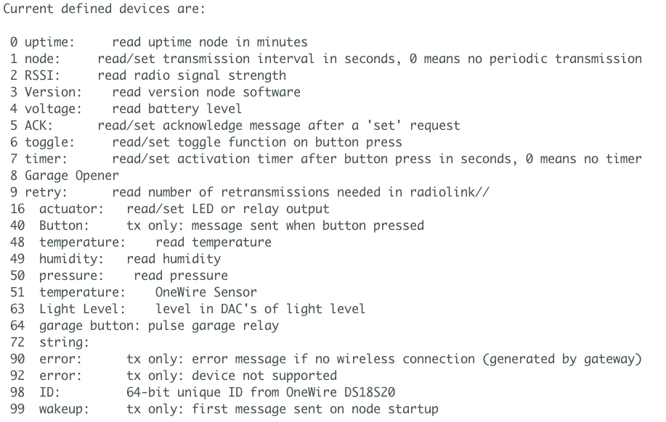
Moteino Sensor Message Protocol
Device Definitions
Structure for Data Transmission over RFM69
Note:
Each Moteino Sensor has a unique nodeID (Each sensor is initialized using RFM_Initializer code)
devID indicates type of data being transmitted
RFM_Node is normal operational code for running sensor
Sensors transmits data ~once per minute and then goes to deep sleep

Slide 5
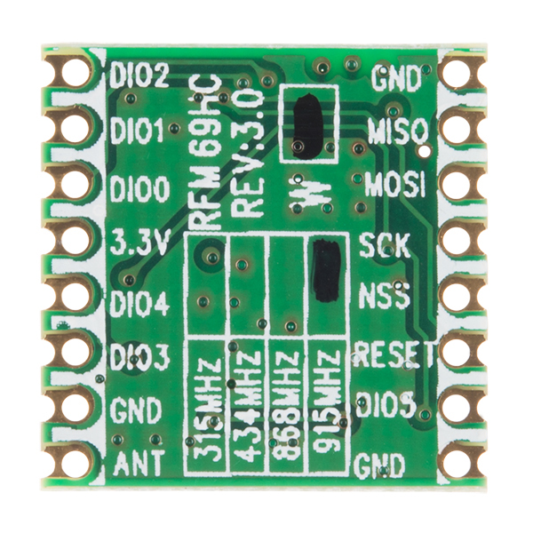
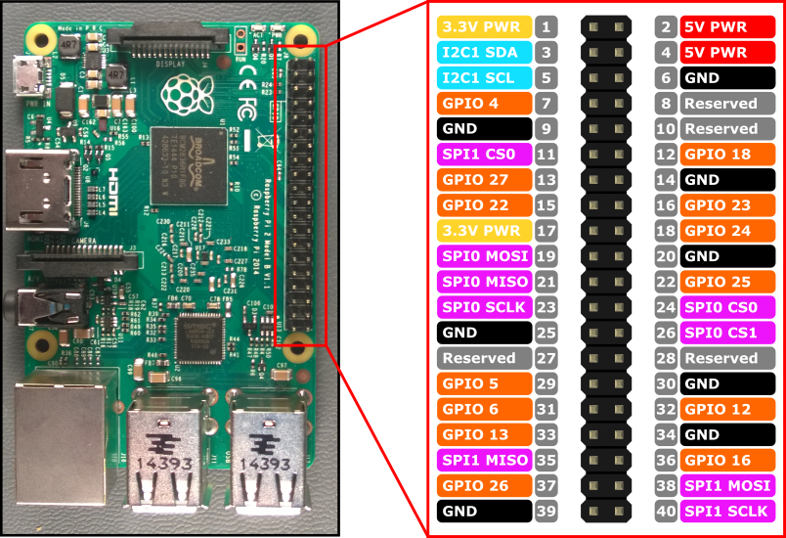
Raspberry Pi 3 with RFM69HCW Transceiver
RFM69HCW Back
RFM69HCW Front
RFM69HCW transmits at 915 MHz
300 kb/sec data rate
128-bit AES hardware encryption
Max. 255 nodes per network
Range: >500 meters line-of-site
Wiring Connections (RFM69 to Pi):
3.3V to pin 17
GND to pin 20
SLCK to pin 23
MISO to pin 21
MOSI to pin 19
NSS to pin 24
DID0 to pin 22

Slide 6
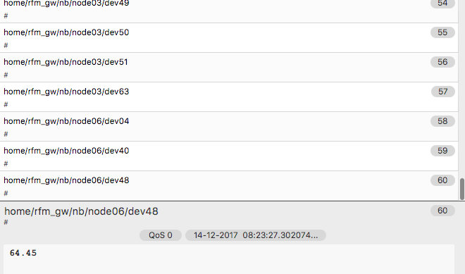
RFM-to-MQTT Gateway on Raspberry Pi 3
A C program runs as a daemon on the Raspberry Pi 3 with the RFM69 transceiver connected to it through SPI and using interrupt lines
Program interprets data structure protocol from Moteino sensor transmissions and resends data as a MQTT stream that can be subscribed to by devices in the network

Slide 7
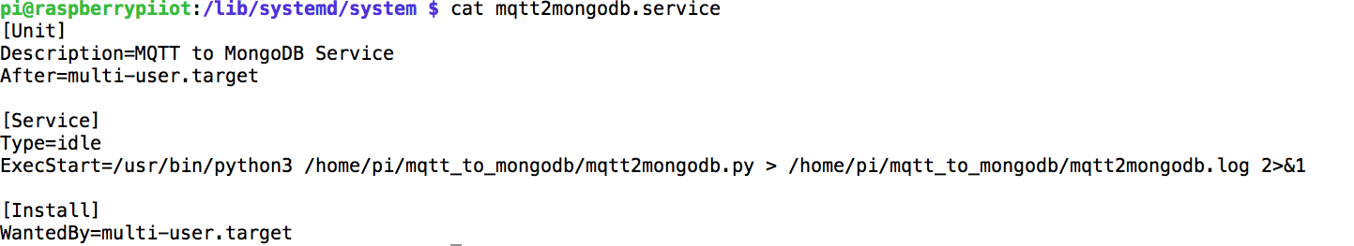
MQTT-to-mongDB Service on Raspberry Pi 3
Configuration file on Raspberry Pi to run mqtt2mongodb.py as a service
To enable and start service:
sudo chmod 644 /lib/systemd/system/mqtt2mongodb.service
sudo systemctl daemon-reload
sudo systemctl enable mqtt2mongodb.service
sudo systemctl start mqtt2mongodb.service
Service will re-start at boot and run continously
Program subscribes to MQTT stream, grabs temperature, humidity, pressure and battery voltage data and packages it together to save as a document in a mongoDB collection

Slide 8
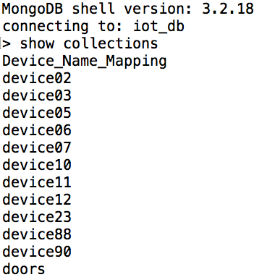
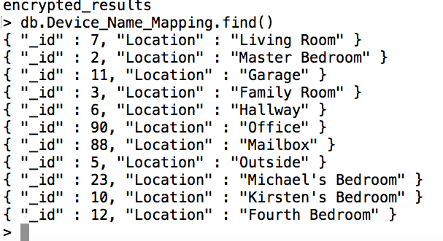
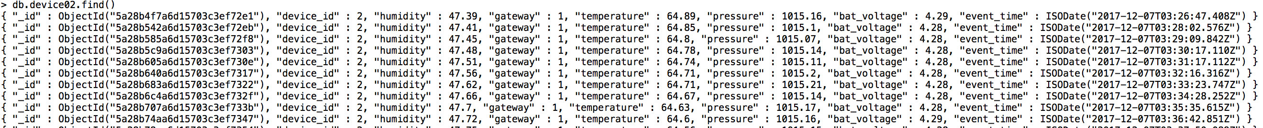
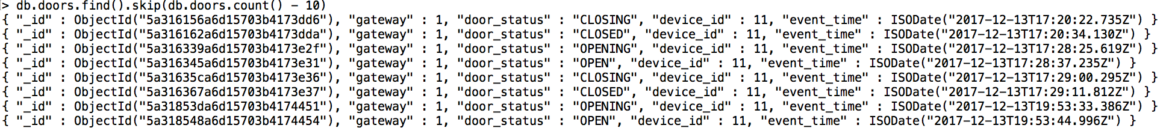
mongoDB iot_db database
Documents in Device_Name_Mapping Collection
Collections in iot_db
Documents in device02 Collection (device02 is the Master Bedroom
Documents in doors collection (“device_id”: 11 is the Garage

Slide 9
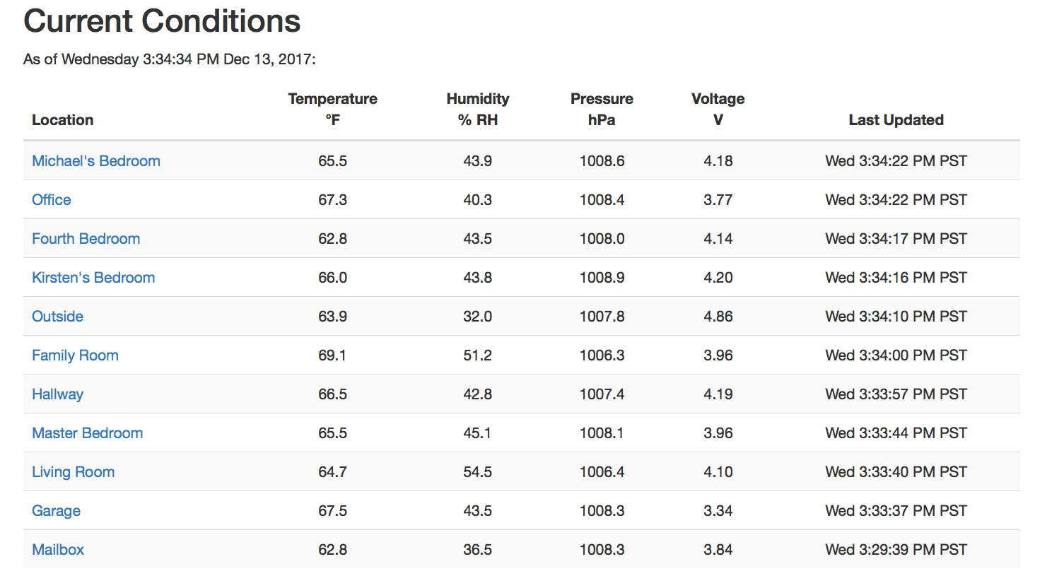
Index Page for Home Monitoring Website

Slide 10
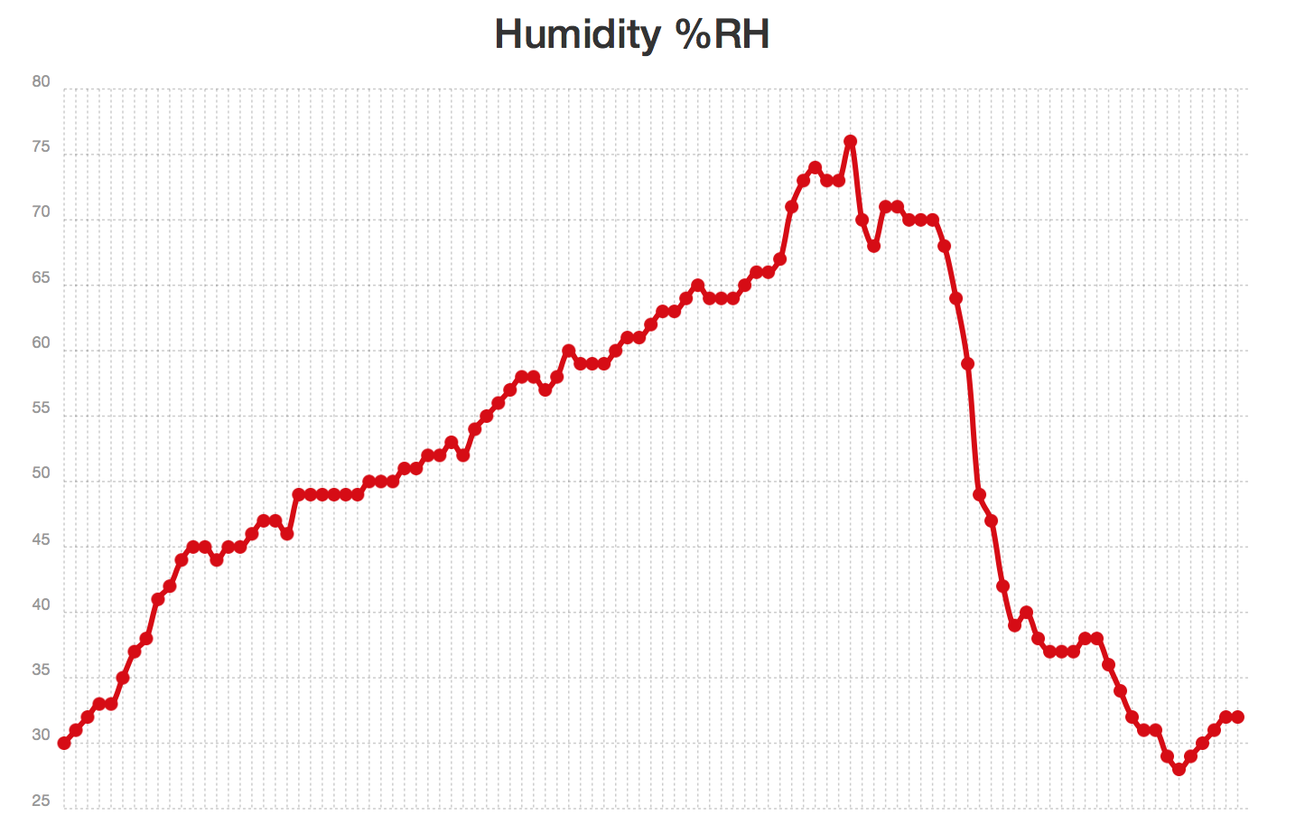
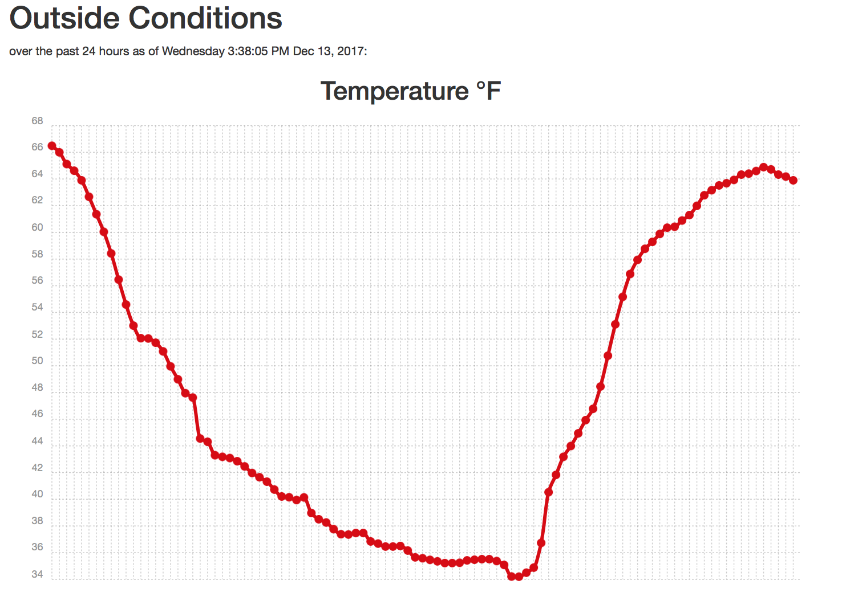
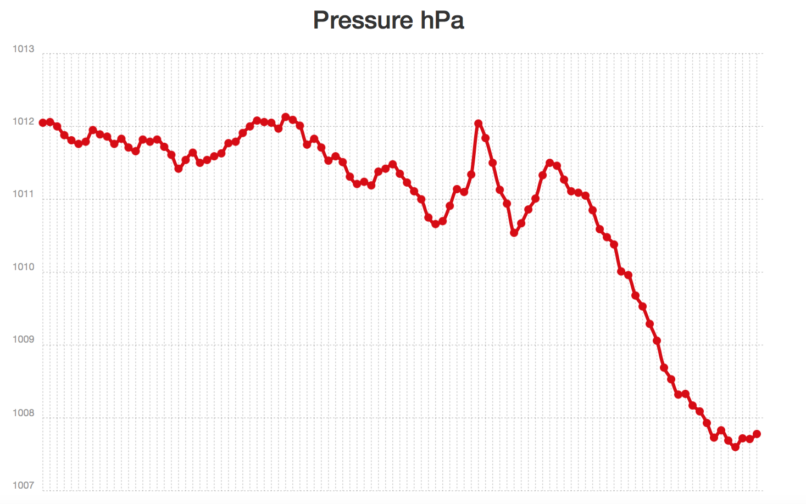
Specific Location Conditions (Reached by clicking on Location)

Slide 11
Security Enhancements
Need to add login system onto flask website server
Username and hashed password will be stored on mongoDB database
Change website from http: to https:
Add encryption to MQTT (currently is password protected but sent in clear text)
Other option is to eliminate MQTT and just have a RFM-to-mongoDB service running, skipping the MQTT all together

Slide 12
Updates
Updates to Moteino Sensors can be done over-the-air (OTA) although not currently implemented. Also there is an issue trying to wake them up from deep sleep to do the OTA update that has to be addressed
Firmware running on Raspberry Pi gateway could occasionally call to a centralized server to check for any software updates for either the gateway or the Moteino Sensors and then push the updates accordingly
Lots of work still needed to address details

Slide 13
Final Comments
Enhancements needed to the Flask web server:
Provide login security
Add ability to get automatic update of garage door opening and closing while website is being viewed,
Add ability to get summary statistics of conditions in each room
Add electronics to control HVAC system (furnace) instead of a normal thermostat
Code for project is available on my github:
https://github.com/wachenda/IOT_Sensors_Platforms_Communications-Class.git

